Slide 1

Punctuation
The Magic Wand for Clear Communication!
Batch: Faculty: Session : Subject:
|| BSAF || Ali Raza || 1B || Functional English

Slide 2

INTRODUCTION :
Hello, everyone! Today, we're going to talk about punctuation, the magical tool that makes our writing clear and easy to understand. Imagine punctuation as the superhero of sentences, guiding us through the world of words. Let's dive in!

Slide 3

What is Punctuation ?
Punctuation is like the traffic director in writing. It helps us know where to stop, pause, and get excited. Just like traffic signs on the road, punctuation signs in writing keep everything in order.

Slide 4

Punctuation Marks :
The Period (.) - The Stop Sign The period is like a stop sign. It tells us when a sentence is finished. It's the boss of full stops in writing.
Example: The sun is shining.
The Question Mark (?) - The Curious Friend The question mark is like a friend who asks questions. It shows curiosity and makes sentences feel like a little mystery.
Example: Where is your book?
The Exclamation Mark (!) - The Excitement Booster The exclamation mark is like adding fireworks to our words. It shouts excitement or strong feelings.
Example: What a beautiful sunset!

Slide 5
The Comma (,) - The Pause Button Commas are like tiny breaks in sentences. They help us catch our breath and make writing easier to follow.
Example: The cat is sleeping, and the dog is barking.
The Apostrophe (') - The Ownership Marker The apostrophe shows who owns what. It's a small but mighty tool.
Example: Sarah's cat is fluffy.
Quotation Marks (" ") - The Speech Frame Quotation marks frame words spoken by someone. They create a special box for speech.
Example: She said, "Hello!"

Slide 6
Colon (:) - The Gateway to More The colon opens the door to more information. It introduces something important or a list.
Example: Remember this: Practice makes perfect.
Semi-Colon (;) - The Middle Ground The semi-colon connects closely related ideas. It's stronger than a comma but gentler than a period.
Example: She loves to read; he prefers watching movies.
Ellipsis (...) - The Trail Off The ellipsis leaves a trail, showing there's more to come. It's like a hint of what's next.
Example: I wonder what will happen next...

Slide 7
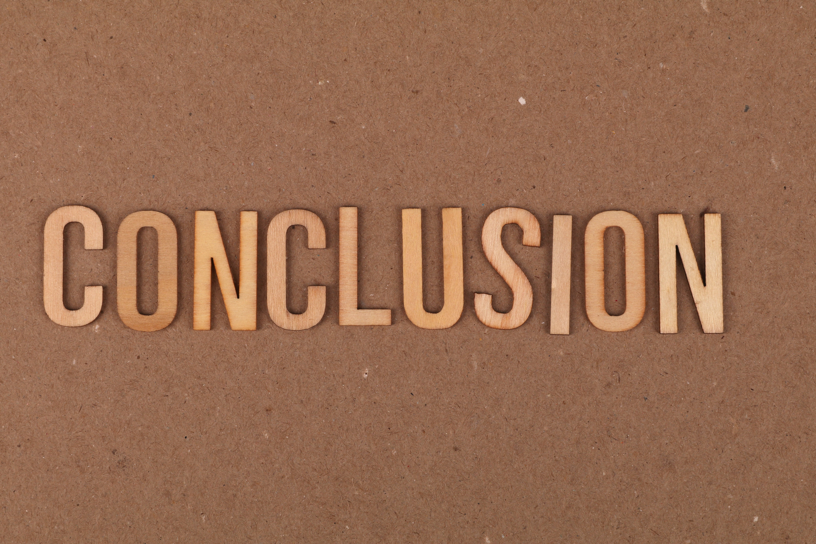
In conclusion, punctuation is like a magic wand for our words. Using it well turns our sentences into a smooth and clear story. So, let's embrace punctuation as our writing friend and create magical, easy-to-understand stories for everyone to enjoy!

Slide 8
Thanks For Watching
|| This presentation is made by our team ||
:

